Slide 1
AI-enabled Fraud & Deception
Group 16: Wenyu HAN
Yuhang HU
Lee Ling LEE
Feng YE
Siyu ZHOU

Slide 2
Table of contents
01
02
03
04
05
Current State
Proposal Initiative
Plan of Action
Project Charter
Conclusion

Slide 3
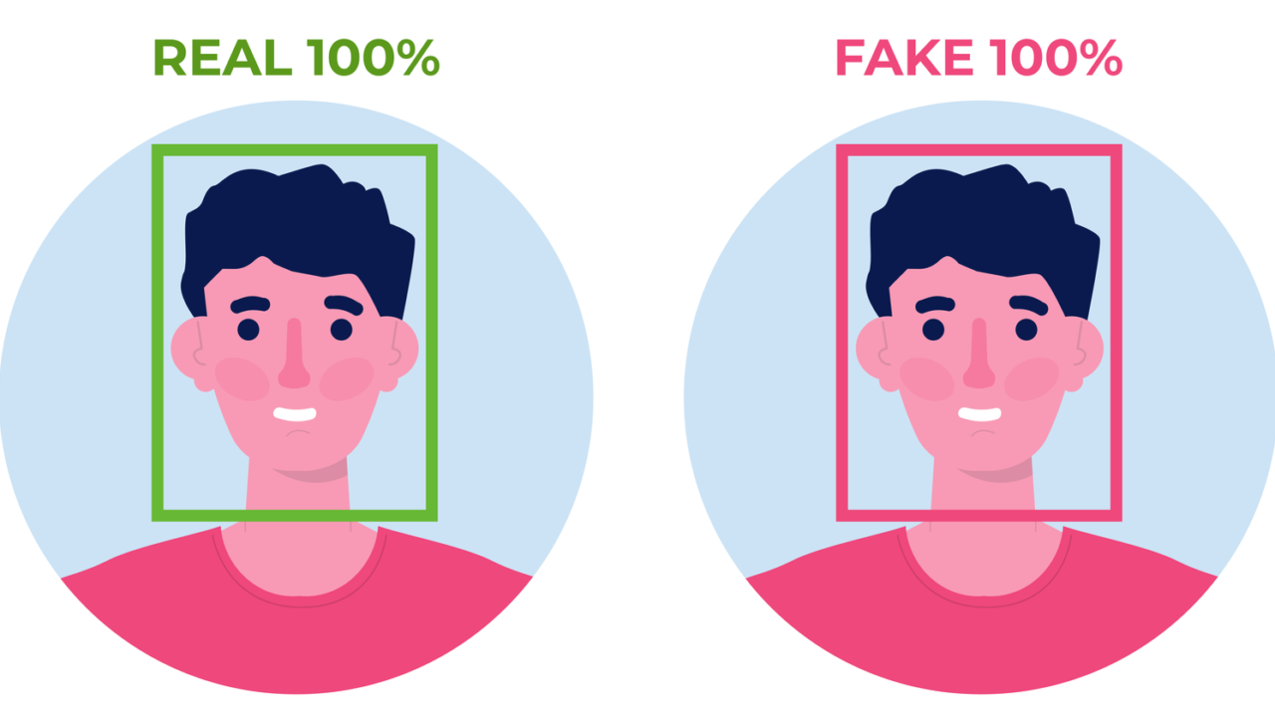
01
Current State
Deepfake AI Algorithm

Slide 4
Case
Hong Kong branch of a multinational company
An employee in finance department received fake message
Joined video meeting with “UK CFO” and “other employees”
secret transactions
No actual interactions
Issued commands before abruptly ended
Suspected early, relaxed vigilance after meeting
15 transfers in 5 Hong Kong bank accounts, totaling HK$2OO million
Realized it was a scam a week later

Slide 5
Issues
Weak Alertness to AI Fraud
Not sensitive for financial activities
Not enough cybersecurity training
Do not report event in time
Imperfect Regulatory System
Do not notice the strange large transfers
Need strict auditing and monitor system
Lack advanced algorithm to detect AI fraud

Slide 6

02
Proposal Initiative
(AI)

Slide 7

Planning & Do
(a) Pretend Deepfake Fraud and Promoting Ethical AI (Plan)
Embracing ISO/IEC 27001 and ISO/IEC 42001 standards
Establishment of a specialized cybersecurity team and AI ethics officers
Implement of advanced biometric technologies
(b) Implementing Our Strategy (Do)
Deploy speech recognition and AI behavior analysis tools
Mandatory Deepfake detection training for all staff
Enforce multi-factor authentication for financial transactions

Slide 8

Check & Act
(c) Compliance and Effectiveness Monitoring (Check)
Continuous monitoring of strategy effectiveness and ethical
Hire third-party security auditors to test
(d) Continuous Improvement (Act)
Update and refine algorithms
Update policies and training programs

Slide 9
Technical & Managerial Requirements
Technical:
Due to the integration of multi-factor authentication(MFA) technology, dedicated internal servers for storing encrypted biometric data, and compatibility of these systems with various communication platforms.
Managerial:
This plan requires mandatory and comprehensive staff training. The cybersecurity group needs to check the systems, reports, potential threats, etc.

Slide 10
Competitive Advantages
Complying with ISO/IEC 27001 and ISO/IEC 42001
Leading the way in protecting data and ethical use of AI
Minimizes fraud losses
Enhances the social and users trust

Slide 11
03
Plan of Action
(AI)

Slide 12
Plan of action
Technologies will be pivotal in initial detection efforts
Training about using AI
Engage with new verification processes (employees)
Foster a supportive environment (managers)
Technical and complex (jobs)
People will be responsible for critical decision-making
Improve algorithms for solving ethics problems (developers)
Double check that AI follows ethics (employees)

Slide 13
Ethics concern
Personal privacy leakage and data leakage
Use voice and facial recognition softwares
Enter passwords with a One-time PIN code or a fingerprint
How to solve
Maintain data for certain purpose
Use good data sets
Give users control of data
Reduce algorithmic bias

Slide 14

Improved skills
Technical skills
Design and improve algorithms
Use AI systems and softwares
Non-technical skills
Communicate with others
Organize training or activities

Slide 15
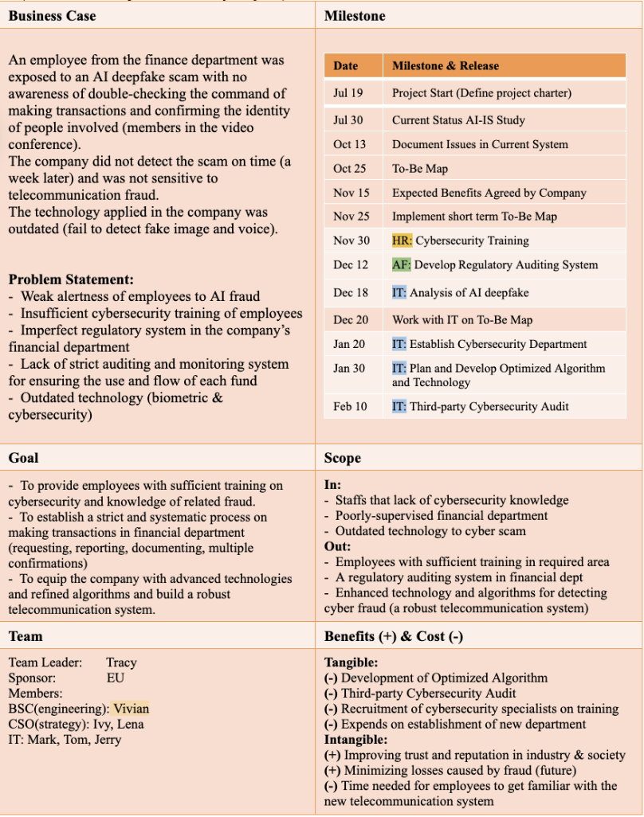
04
Project Charter
(AI)

Slide 16
Project Charter
- Business case → Problem Statement
(1) Employee
→ Weak alertness of employees to AI fraud
→ Insufficient cybersecurity training of employees
(2) Financial Department (Company)
→ Imperfect regulatory system in the financial department
→ Lack of strict auditing and monitoring system
(3) Technology
→ Outdated technology (biometric & cybersecurity)

Slide 17
Goal
(1) Employee
Sufficient training on cybersecurity & knowledge of related fraud
(2) Financial Department (Company)
A regulatory auditing system
a systematic process on making transaction
(requesting → reporting → documenting → multiple confirmations)
(3) Technology
Advanced technology & refined algorithms → robust telecommunication system

Slide 18
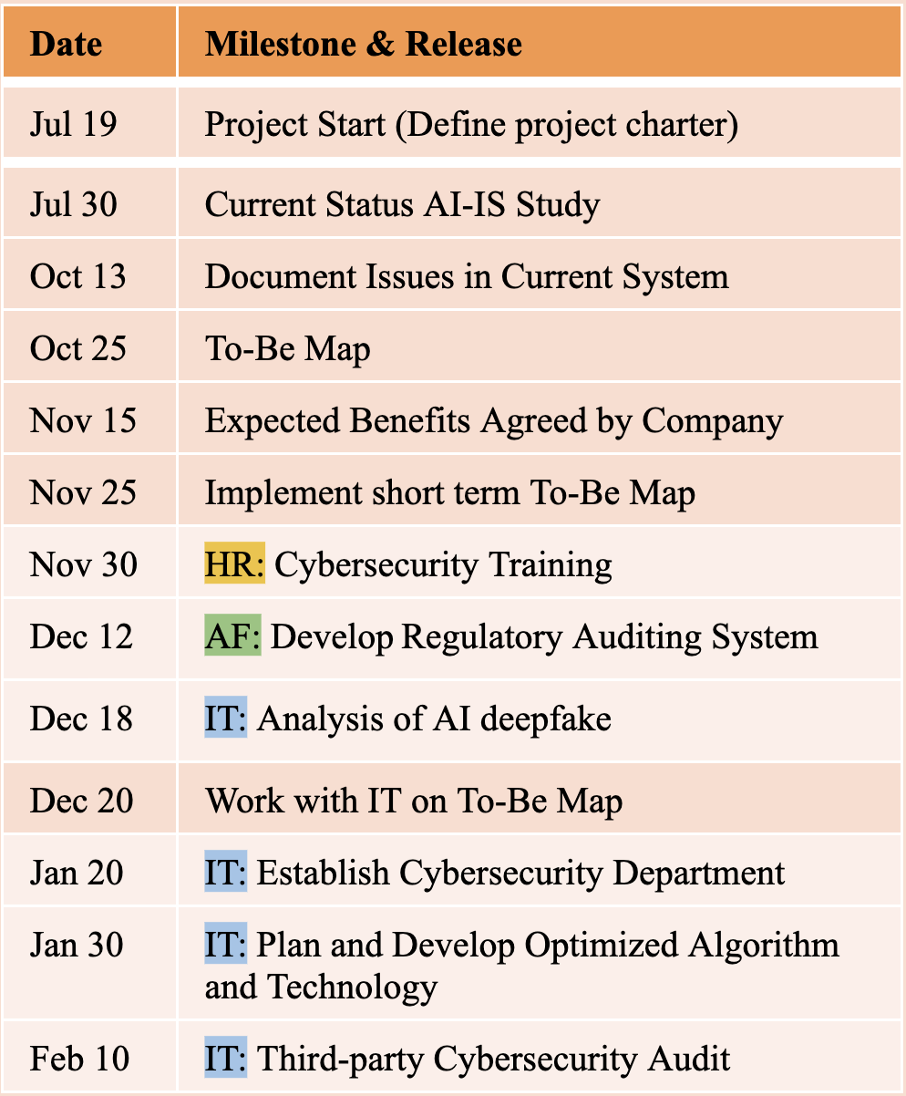
Milestone
Cross Department plan
HR: Human Resource
AF: Accounting & Financial Dept
IT: Information Technology
Actions can be taken in parallel in different departments

Slide 19
Project Charter
- Benefit (+) & Cost (-)
(1) Tangible
(-) Optimizing Algorithm
(-) Third-party Cybersecurity Audit
(-) Recruitment of cybersecurity specialists on training
(-) Establishment of new department
(2) Intangible
(+) Improving trust and reputation in industry
(+) Minimizing losses caused by fraud (future)
(-) Time needed for employees to get familiar with the new system

Slide 20
05
Conclusion/Solution
(AI)

Slide 21
To combat AI fraud
Advanced cybersecurity measures
AI detection tools, security algorithm
AI fraud training courses
Improve the current company systems

Slide 22
Success of the plan
Reduction in fraud attempts
Improve employee proficiency in managing new system
Gain positive stakeholder feedback
Monitor ethical performance to ensure AI alignment

Slide 23
Finally
Achieve data management secure
Prevent future tragedies
Regain public trust and trust against customer
Minimize AI fraud losses

Slide 24
Reference
Brad,M. (2021, October 28). 4 Ways to Preserve Privacy in Artificial Intelligence.
https://www.boozallen.com/s/solution/four-ways-to-preserve-privacy-in-ai.html
InfoSec. (2024, April 2). InfoSec: Deepfake.
https://www.infosec.gov.hk/en/knowledge-centre/deepfake
ISO/IEC 27001:2022. (2022, October). ISO. https://www.iso.org/standard/27001
ISO/IEC 42001:2023. (2023, December). ISO. https://www.iso.org/standard/81230.html
Kong, H. (2024, February 4). ‘Everyone looked real’: multinational firm’s Hong Kong office loses
HK$200 million after scammers stage deepfake video meeting. South China Morning Post.
https://www.scmp.com/news/hong-kong/law-and-crime/article/3250851/everyone-looked-real-multinational-firms-hong-kong-office-loses-hk200-million-after-scammers-stage

Slide 25
Thanks!
Any questions?

